Slide 1
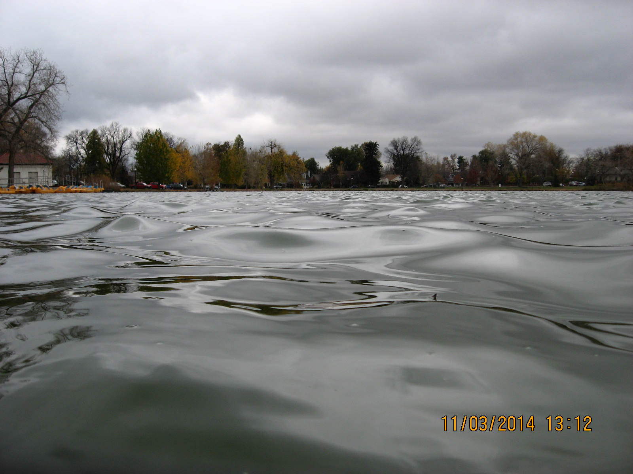

Washington Park Lakes Update
Washington Park Lakes Update
FANs 2/7/24
FANs 2/7/24
Alan Polonsky
Dept Public Health & Environment
Alan Polonsky
Dept Public Health & Environment

Slide 2
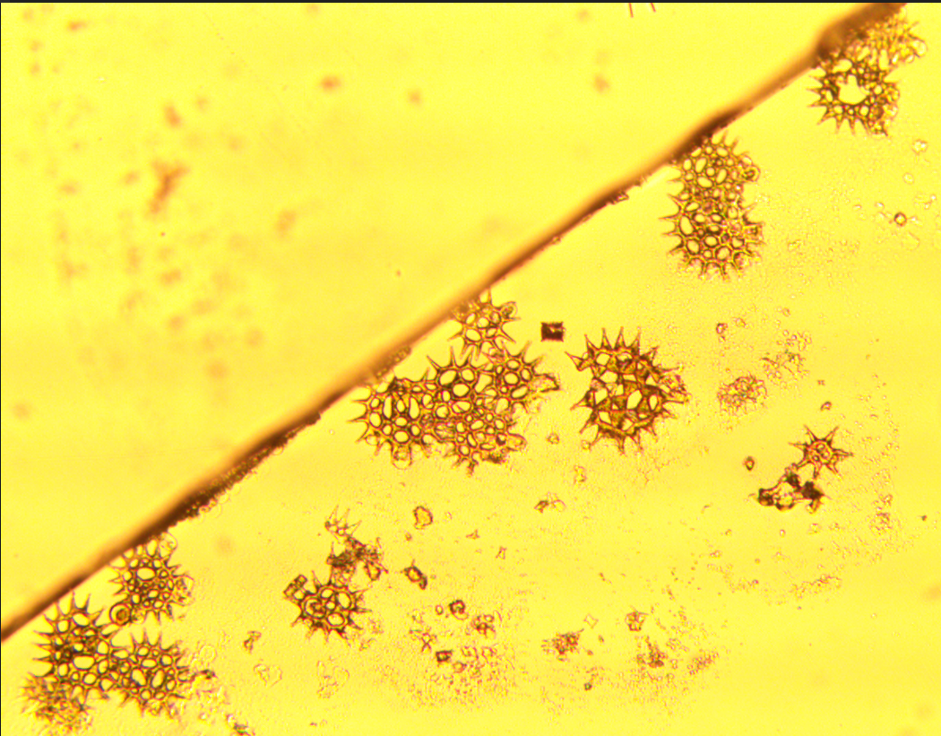
Cover
>Background on Water Source and Lake Management
>Salt (chloride)
>Nutrients
Nitrogen
Phosphorus
>Productivity Measures (chlorophyll, pH, dissolved O2)
>General Updates (management, wildlife)

Slide 3
Background – Water & Management
TREX / I-25 renovation
Recycled Water
Potable Water
Recycled Water & limited storm runoff
S Platte River / Storm runoff
2002
2004
05
2017
2 - SBs in GRZ
-SB from GRZ to SMT
-GB in GRZ

Slide 4
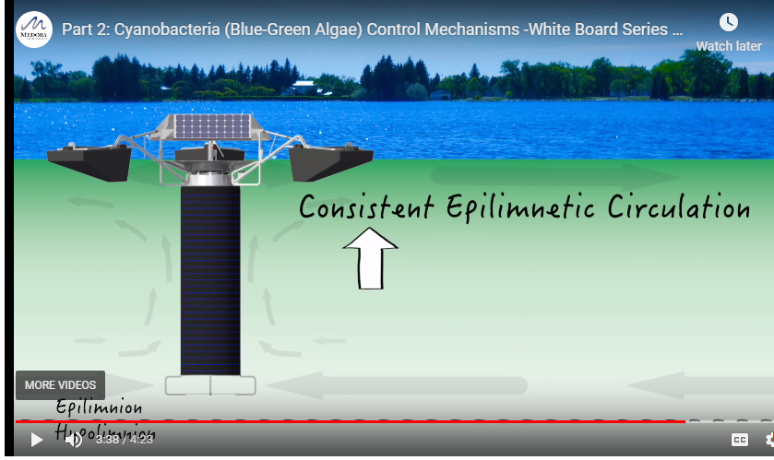
Background

Slide 5
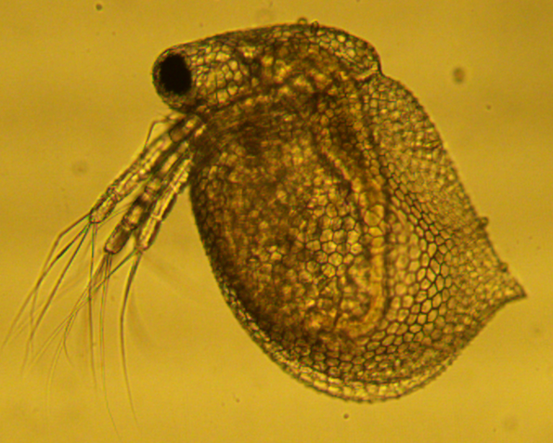
Chloride mid-summer (2008-2023)
Grasmere
210
Smith
ditch
180
150
120
chloride (mg/L)
90
60
30
0
  Chloride (mg/L) EPA CWQG
acute: 860 640
chronic: 230 120
mussels, clams
Daphnia magna: 621
Cladocerans: 400’s
USEPA: http://water.epa.gov/scitech/swguidance/standards/criteria/current . . .
Canadian WQ Guideline: http://ceqg-rcqe.ccme.ca/download/en/337

Slide 6
R² = 0.81
*data from annual Grasmere Lake – midsummer sample visits (2008-2023)

Slide 7
City Ditch Lakes
Grasmere
Ferril
Specific Conductivity (1997-2023)
Smith
Duck
1300
1100
900
Specific Conductivity (uS/cm)
700
500
no sampling
300
100
1997
1999
2001
2003
2005
2007
2009
2011
2013
2015
2017
2019
2021
2023

Slide 8
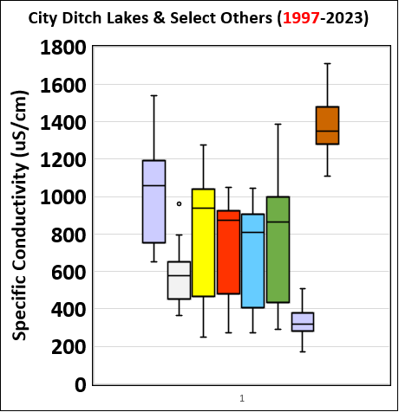
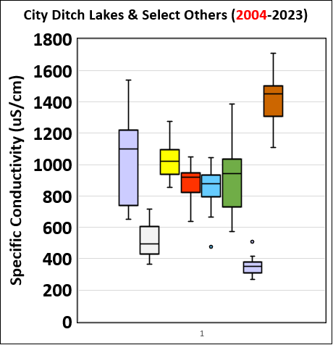
BER
GRS
FER
GAR
RMT
SMT
DUK
LOL
BER
GRS
FER
GAR
RMT
SMT
DUK
LOL
WASH
CITY
WASH
CITY
PARKS
PARKS

Slide 9
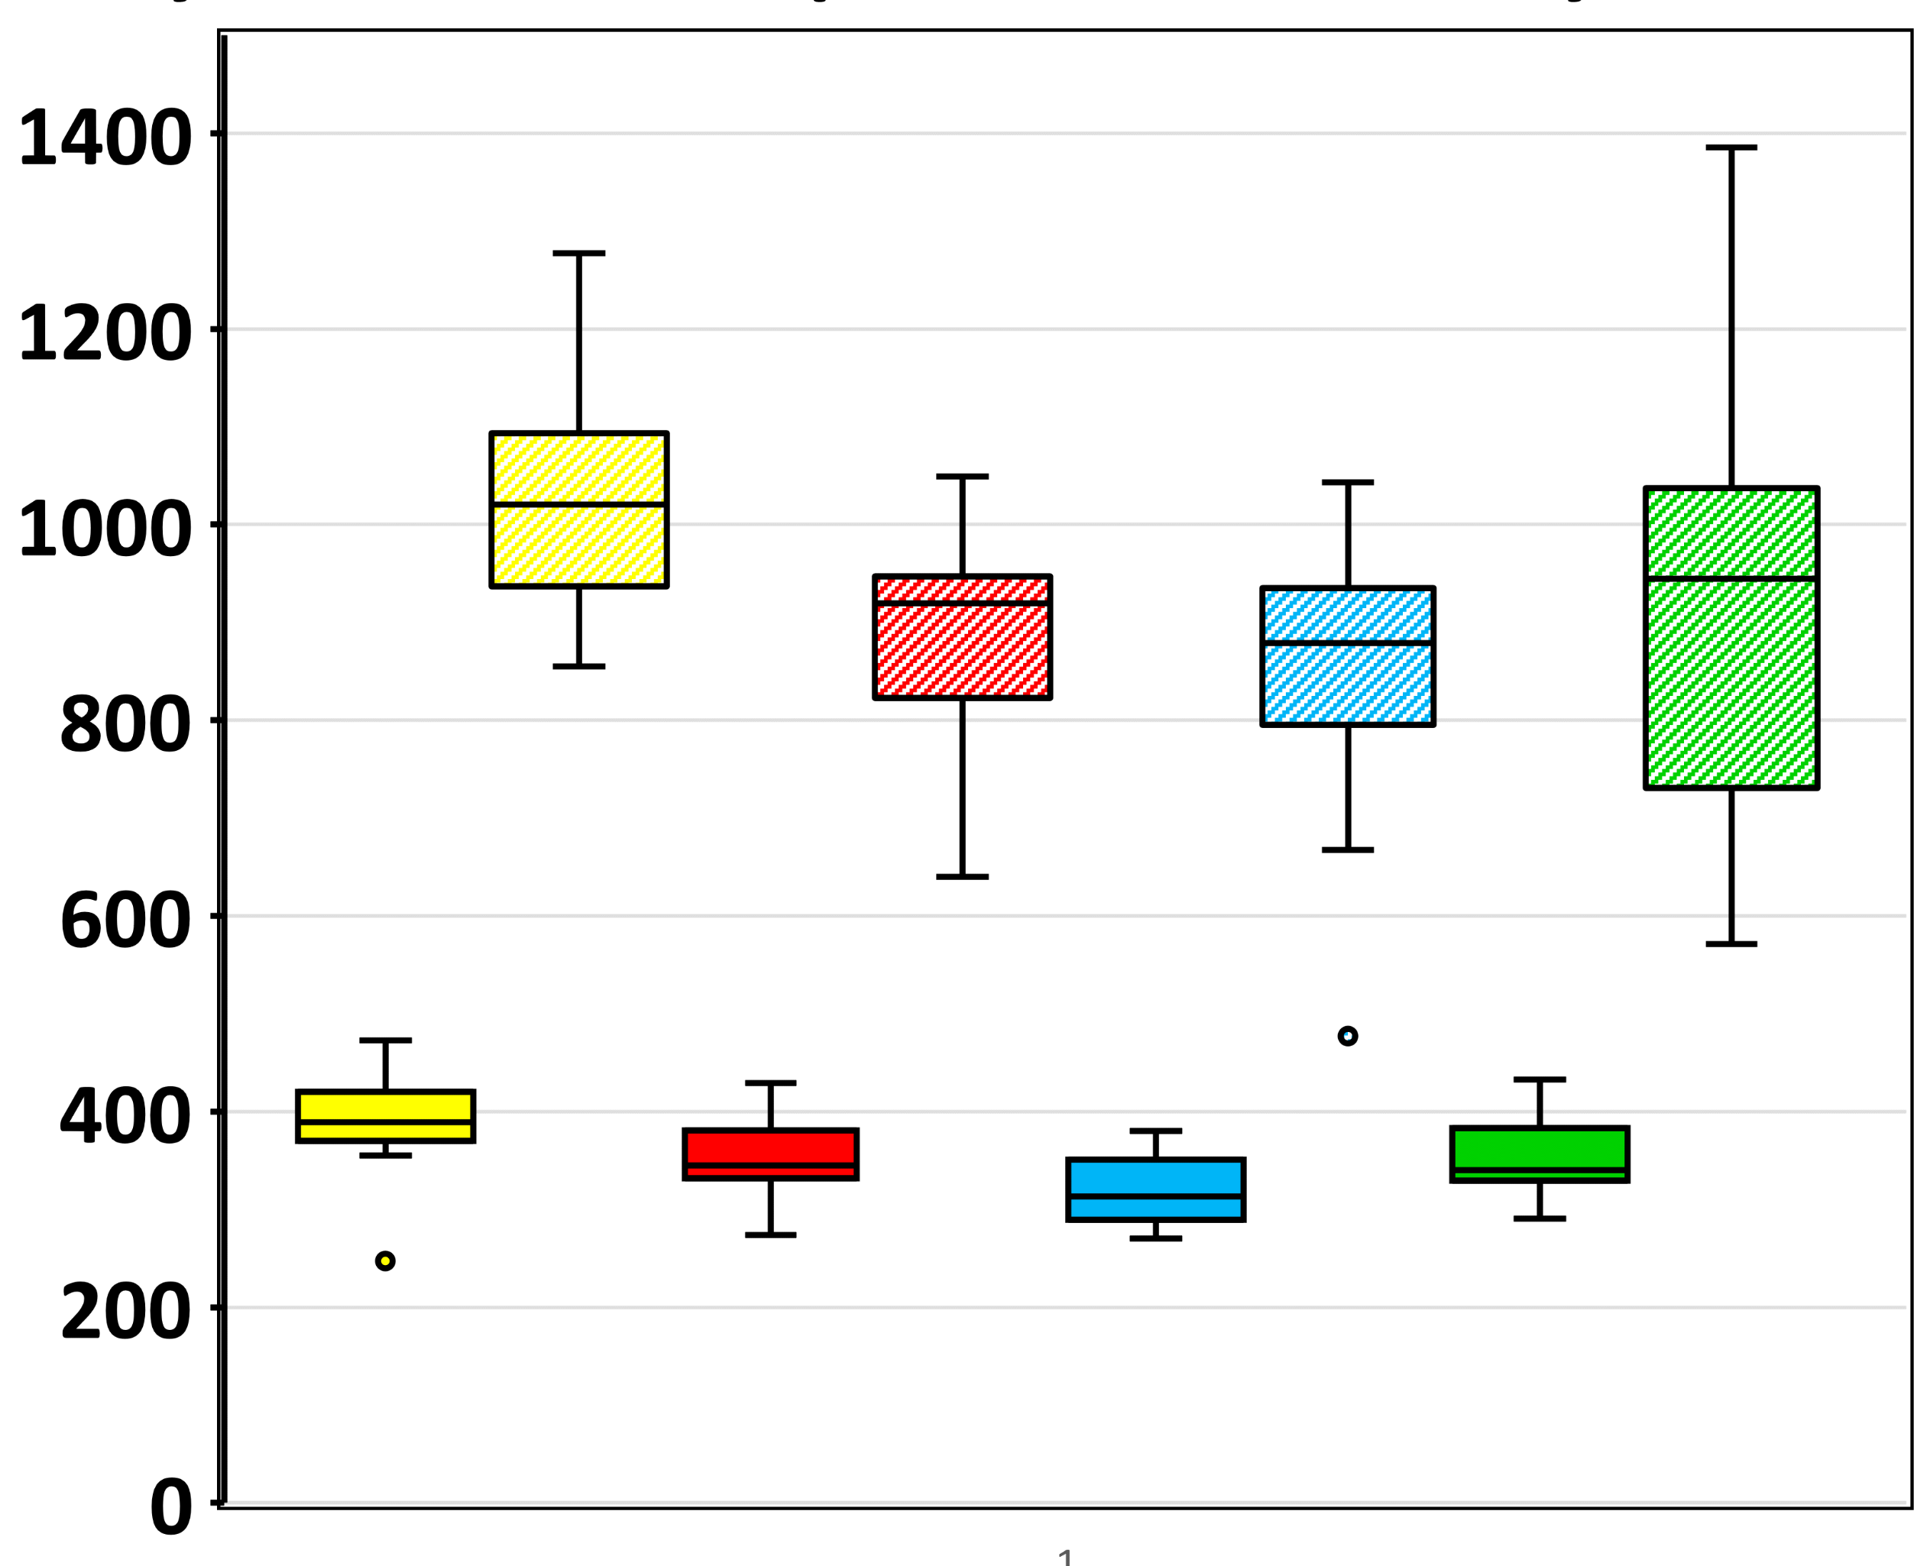
Specific Conductivity – Before & After Switch to Re-use Water
Pre-recycled use: 1997-2003
Post-recycled use: 2004-2023
Specific Conductivity (uS/cm)
pre-post
pre-post
pre-post
pre-post
GRS
SMT
CPL
DUK
WASH PARK
CITY PARK
Bottom Line: Improving, will dig into this to find out what changed.

Slide 10
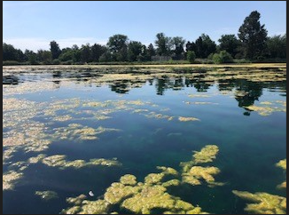
Nutrients

Slide 11
Nitrogen - City Ditch Lakes (1997 – 2023)
Grasmere
Ferril
Smith
Duck
14
12
10
8
Total N as N (mg/L)
6
4
2
no sampling
0

Slide 12
Nitrogen (1997- 2023)
12
Org-N
Grasmere
10
NO₃
8
NO₂
NH₄
6
4
2
0
Nitrogen (mg/L as N)
Smith
10
8
6
4
2
0
1997
1999
2001
2003
2005
2007
2009
2011
2013
2015
2017
2019
2021
2023

Slide 13
Nitrogen - City Ditch (2005 – 2023)
18
Org-N
15
NO₃
NO₂
12
NH₄
Nitrogen (mg/L as N)
9
6
3
0
2005
2017c
2018c
2019d
2020b
2008
2010
2013
2016
2023
2009b
2012b
2017b
2018b
2019b
2019e
2009a
2012a
2017a
2018a
2019a
2019c
2020a
2011
2014
2015
2021
2022
Bottom Line: Improving, wastewater treatment enhancements driving lower nitrate concentrations

Slide 14
Grasmere
-
Phosphorus
total-P
ortho-P
0.5
0.4
0.3
phosphorus (mg/L as P)
0.2
0.1
0.0
1997
1999
2001
2003
2005
2007
2009
2011
2013
2015
2017
2019
2021
2023

Slide 15
Phosphorus - City Ditch (2005 – 2023)
Total-P
Ortho-P
0.30
0.25
0.20
Phosphorus (mg/L as P)
0.15
0.10
0.05
0.00
2005
2009
2011
2013
2015
2017
2019
2021
2023
Bottom Line: Improving, wastewater treatment enhancements driving lower nitrate concentrations are also impacting phosphorus

Slide 16
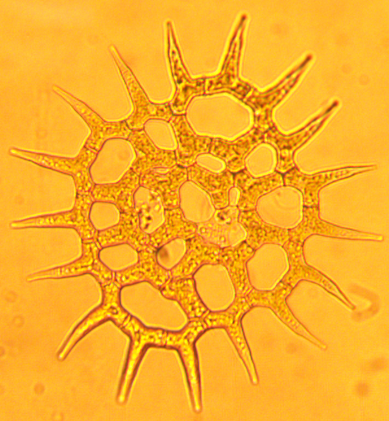
phytoplankton
Diss O₂ and pH
Filamentous/rooted plants
low
high
Algal Productivity

Slide 17
Productivity Measures
Chloro-a
Secchi
Grasmere
pH
11
180
160
10
140
9
120
8
100
pH (su)
Chlorophyll-a (ug/L) & Secchi Depth (in)
7
80
6
60
40
5
20
4
0
3
2001
2003
2005
2007
2009
2011
2013
2015
2017
2019
2021
2023
phytoplankton
filamentous

Slide 18
Productivity Measures
Chloro-a
Secchi
Smith
pH
11
180
160
10
140
9
120
8
100
pH (su)
Chlorophyll-a (ug/L) & Secchi Depth (in)
7
80
6
60
40
5
20
4
0
3
2001
2003
2005
2007
2009
2011
2013
2015
2017
2019
2021
2023

Slide 19
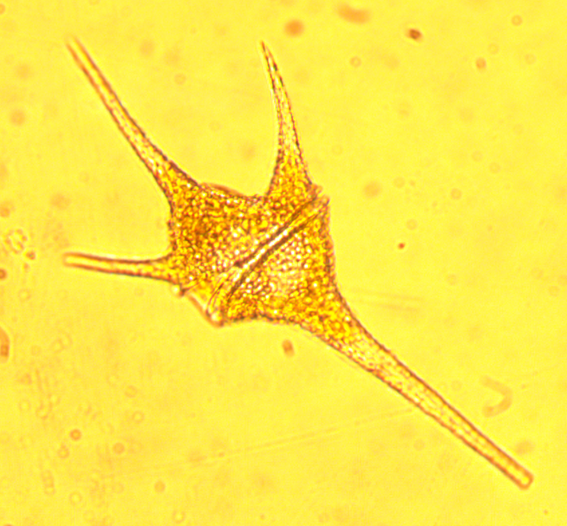
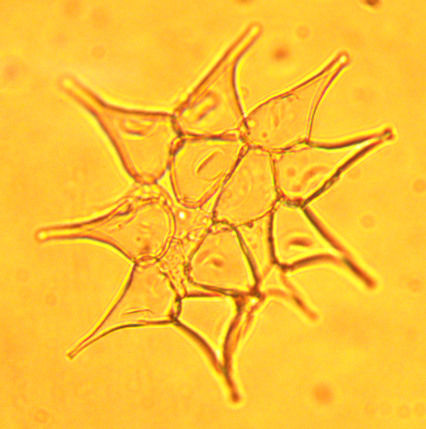
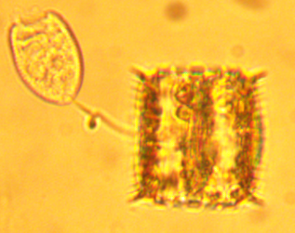

Slide 20
phytoplankton
Diss O₂ and pH
Filamentous/rooted plants
low
high
Algal Productivity

Slide 22
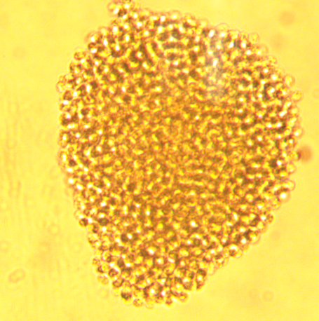
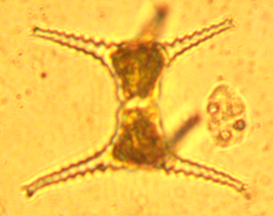
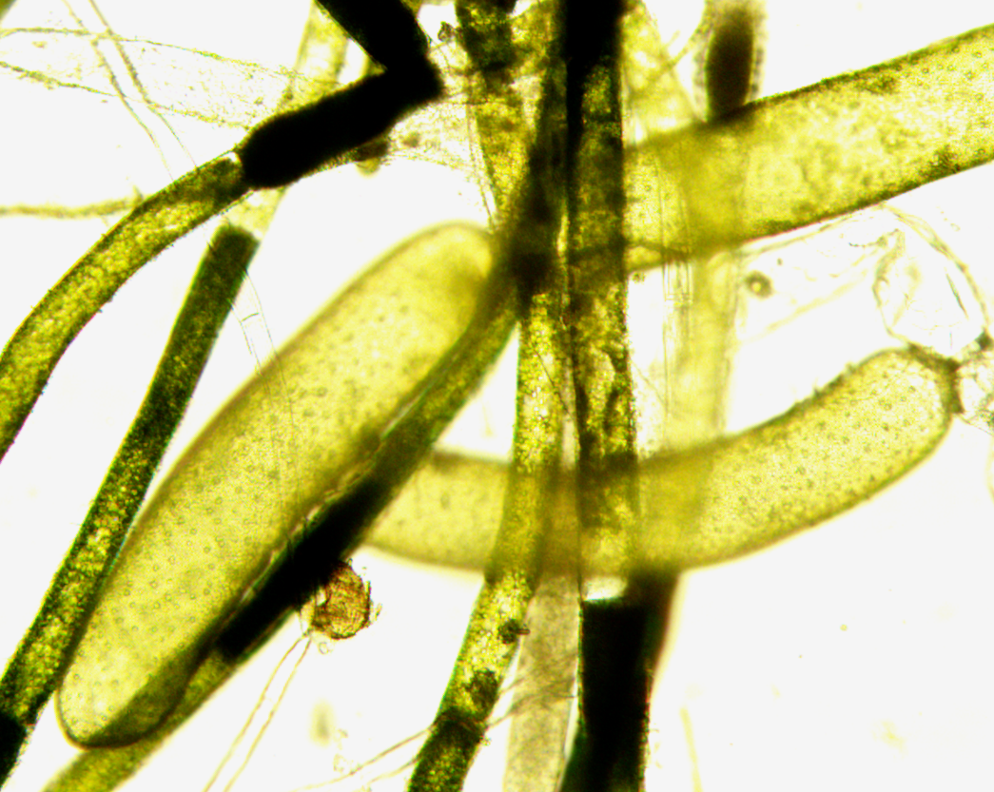
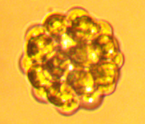

Slide 23
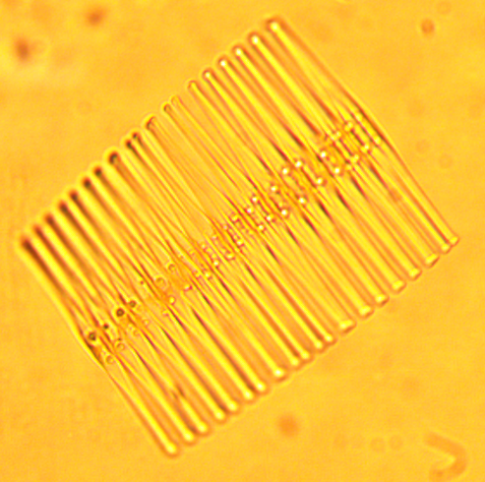

Slide 24
Management Updates?
new aeration in Lilly Pond
utilizing variety of algacide options beyond the traditional CuSO4
plans for new aeration in Smith and Lily
Wildlife Updates?
fewer avian botulism, but
avian influenza already impacting waterfowl

Slide 26
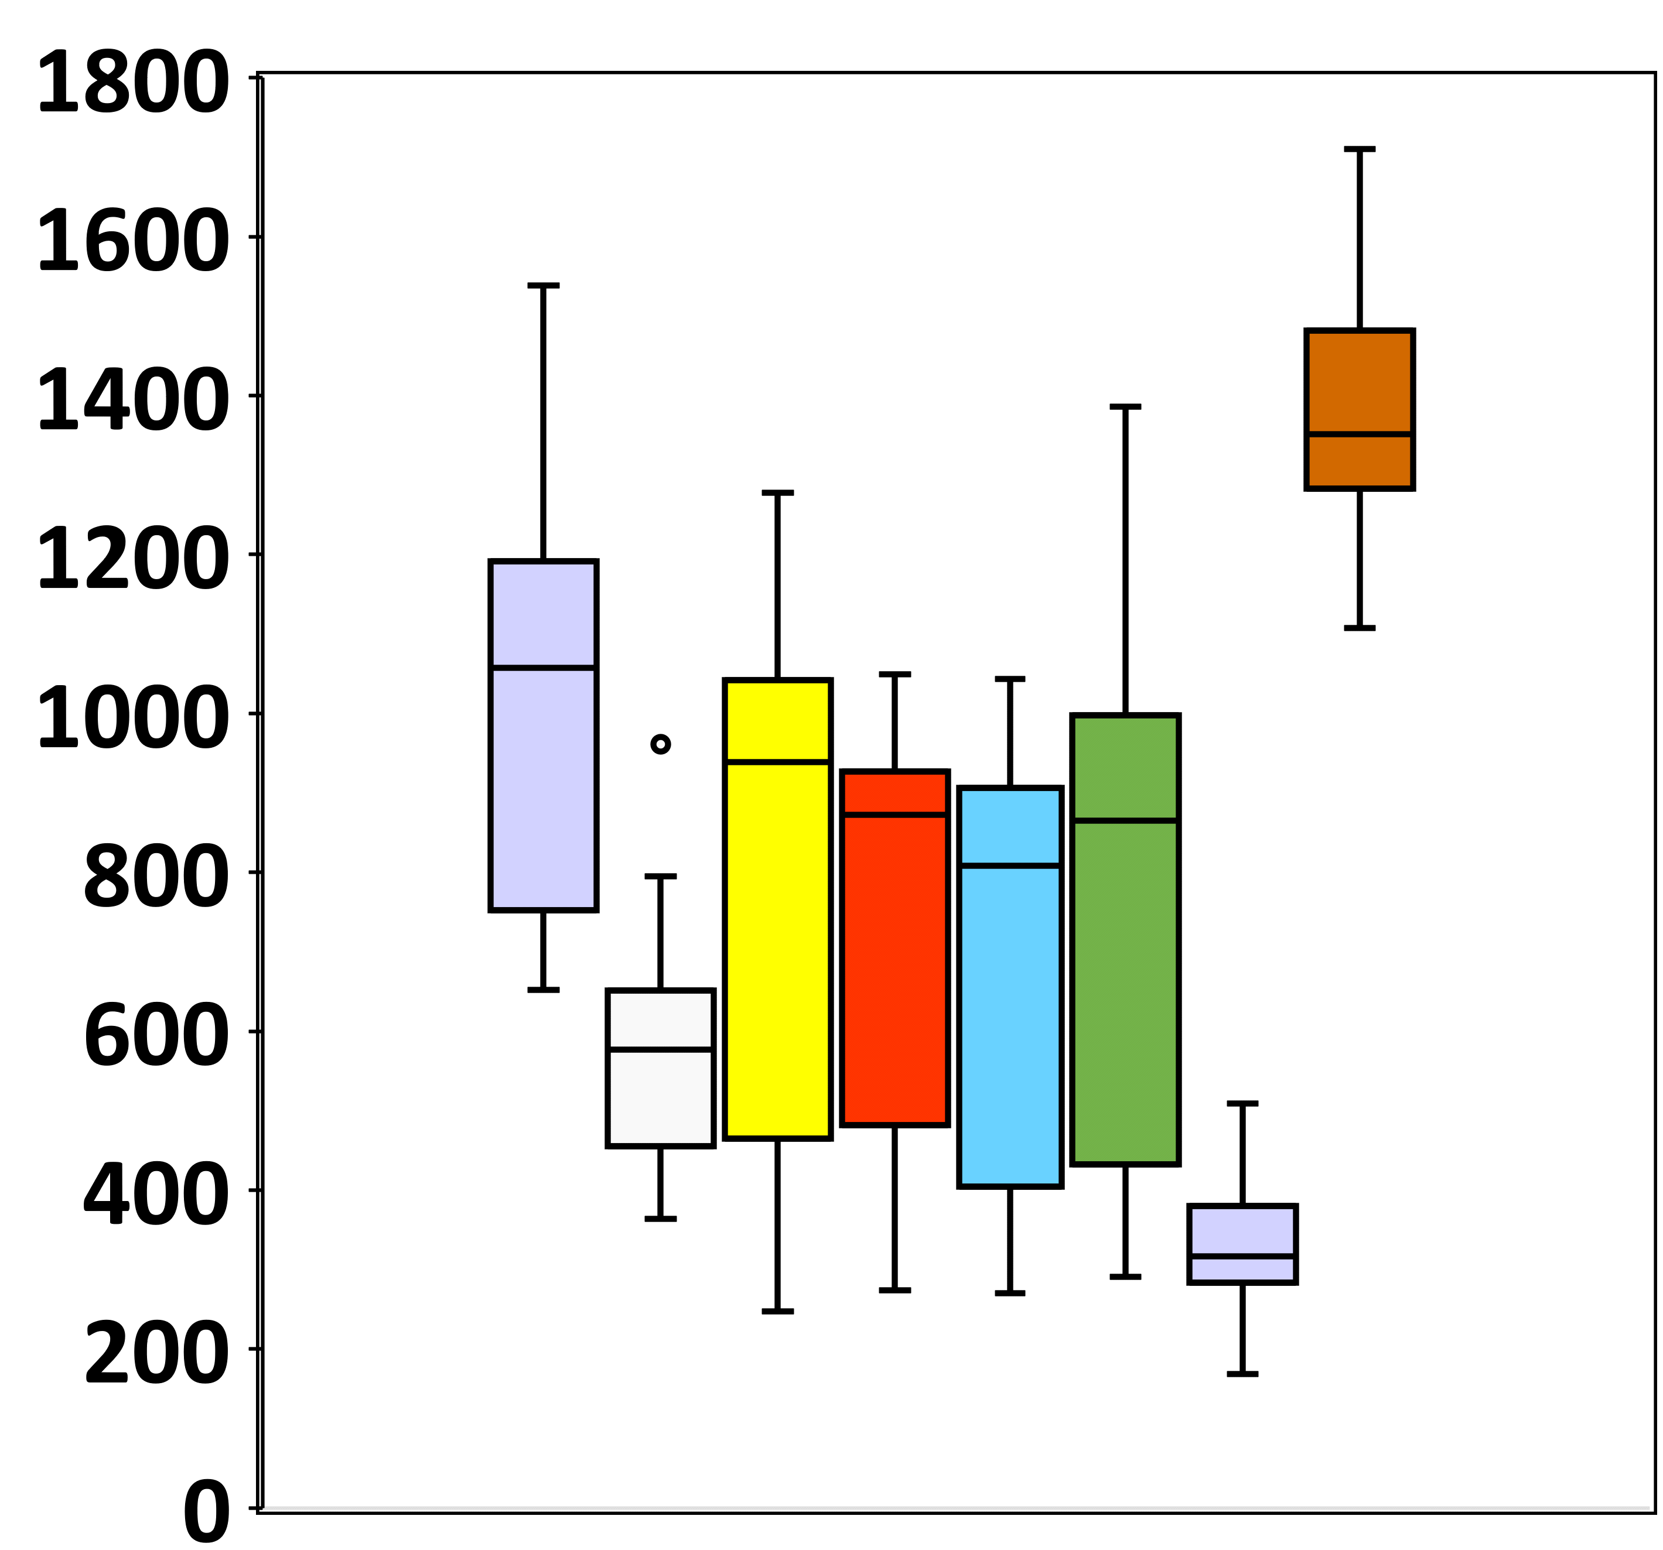
Specific Conductivity (1997-2023)
City Ditch Lakes & Select Others
(1997-2023)
(2004-2023)
Specific Conductivity (uS/cm)
BER
GRS
FER
BER
GRS
FER
GAR
GAR
LOL
RMT
SMT
DUK
LOL
RMT
SMT
DUK
WASH
CITY
WASH
CITY
PARKS
PARKS

Slide 27
Nitrogen - City Ditch (2005 – 2023)
Nitrogen
-
Ditch @ Grasmere (2005
-
2023)
18
TIN
Org-N
15
12
Nitrogen (mg/L as N)
9
6
3
0
8/5/08
7/20/10
9/20/12
7/27/15
8/7/17
10/18/18
8/1/19
7/21/20
7/26/22
7/14/05
5/20/09
7/22/09
8/25/20
4/19/11
7/20/21
7/31/23
8/16/12
8/8/13
7/24/14
7/14/16
7/17/17
10/9/17
7/30/18
10/2/18
5/23/19
6/27/19
8/8/19
10/23/19

